Slide 1
HACKING HTML5

Slide 2

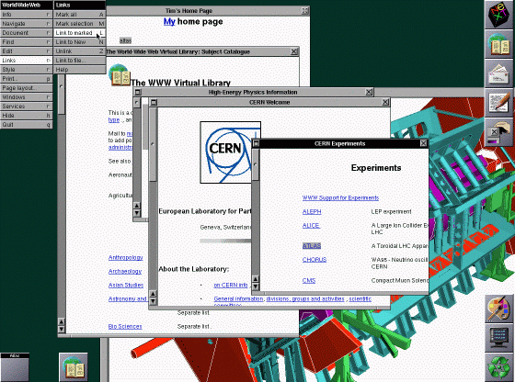
BASICS OF HTML
HISTORY
1980 Tim Berners-Lee prototyped a system called ENQUIRE to share research documents. It was based on a book called “Enquire Within Upon Everything” (How-To’s of Domestic Life)
1989-1991 Tim Berners-Lee & Robert Cailliau ,independently from CERN, expanded ENQUIRE to an Internet-based hypertext system called HTML. (Original proposal to CERN which got rejected for funding!)
Nov 1995- May 2000 HTML versions 2.0,3.2,4.0,4.01, ISO/IEC 15445:2000 were released. Currently HTML 4.01 & ISO/IEC 15445:2000 are the stable HTML versions.
Today HTML5.1 is in the “Candidate recommendation” phase. Year end should see a “Last Call” for the specdification finalization.
http://www.evolutionoftheweb.com/

Slide 3
BASICS OF HTML
INTRO
HyperText Markup Language – It is a markup language and NOT a programming
language
Tags , enclosed in Angle Brackets <>
<html>, <body>,<p>,etc.
Attributes
<html lang=“en”>, <p class=“demo”>,etc.
Comments
<!-- This is a comment -->
Structure
<body> must be inside <html> tags
Display / Styling
CSS files, style attribute in HTML tags, (new) Animation
DOM (Document Object Model)
HTML elements, nodes, events, attributes
Scripting
Dynamic DOM manipulation, animation techniques, Events

Slide 4
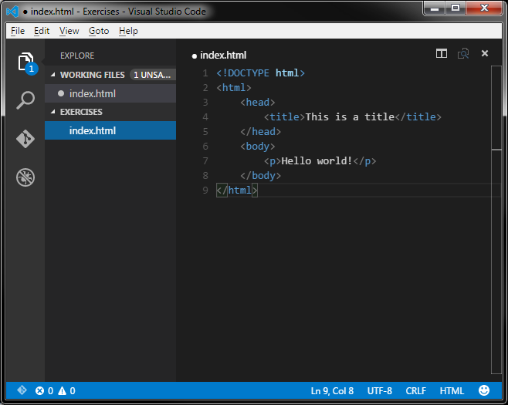
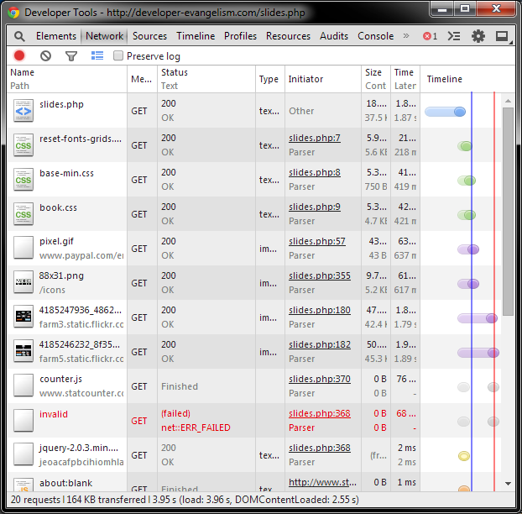
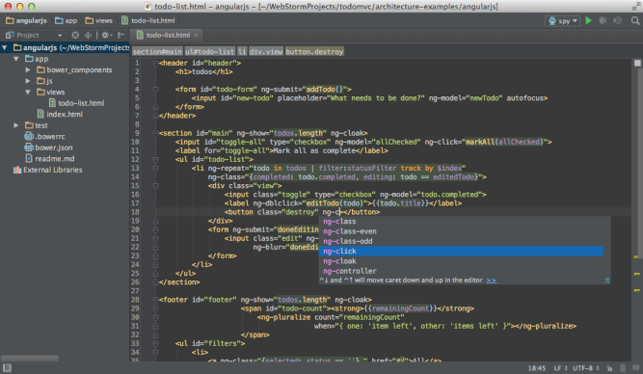

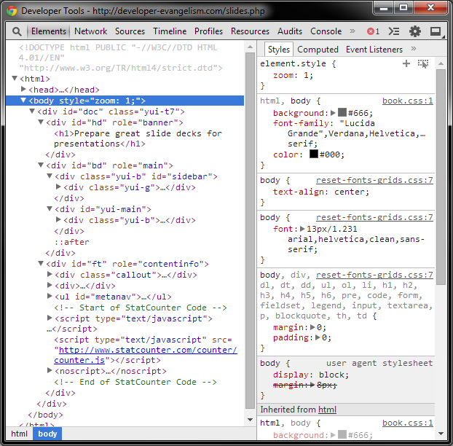
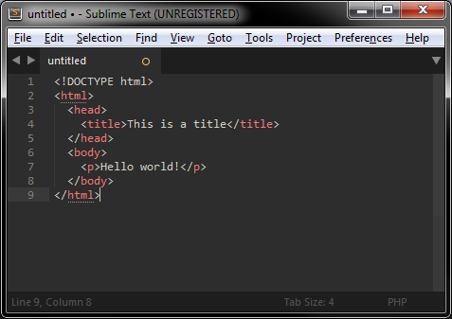
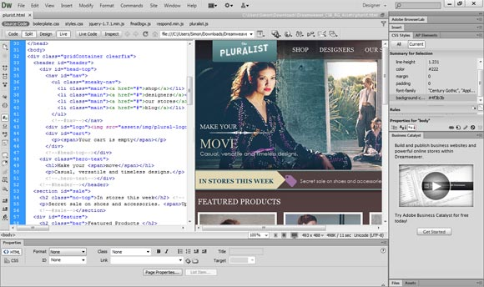
BASICS OF HTML
TOOLS
Simple Editor
Complete IDEs
Debugging
Visual Studio Code
Jetbrains WebStorm
Adobe Dreamweaver
Sublime Text 3
Chrome Developer Tools (press F12)

Slide 5
EXERCISE – DAY 1
“HELLO WORLD” WEBPAGE
<!DOCTYPE html>
<html lang="en">
<head>
<title>Hacking HTML5</title>
<meta charset="utf-8" />
</head>
<body>
Welcome to the <b>Hacking HTML5</b> class !
</body>
</html>

Slide 6
BASICS OF HTML
“HELLO WORLD” WEBPAGE
<!DOCTYPE html>
<html lang="en">
<head>
<meta charset="utf-8" />
<title>Hacking HTML5</title>
</head>
<body>
Welcome to the <b>Hacking HTML5</b> class !
</body>
</html>
Document Type Declaration (DTD) – markup language syntax (HTML, Transitional, Strict, Frameset, XHTML 1.1)
<html> tag encapsulates the complete visible and instructional parts of the webpage. lang is its attribute.
<head> tags enclose mostly non-visible instructional data for the web browser.
<meta> tag is an instructional tag which defines metadata – static description like author, etc. ; how the browser should behave when displaying the page. In this example we set character encoding for the page content.
<title> tag defines the Page title displayed on the browser tab
<body> tag encapsulates the data which will be made visible to the user by the browser
<b> tag tells the browser to provide emphasis on the text with the open and close tags i.e. to make the text BOLD
With HTML5, <strong> should be used instead.
Ideally style manipulation should be done using CSS text-weight property.

Slide 7
HOW TO USE DEBUGGER?

Slide 8
BASICS OF HTML
HTML TAGS
TEXT FORMATTING
<h?> … </h?> | Heading (? = 1 for largest to 6 for smallest) e.g. h1,h3,etc.
<b> …</b> <strong> … </strong> | Bold Text (‘Strong’ tag shows bold for most browsers)
<i> …</i> <em> …</em> | Italic Text (‘Emphasis’ shown as italics for most browsers)
<u> …</u> | Underline Text
<blockquote> …</blockquote> | Text Block Quote
<sup> …</sup> <sub> … </sub> | Superscript text and subscript text respectively
<a href=“http://...#bookmark”> … </a> <a href=“mailto:...”> … </a> <a href=“tel:...”> … </a> | Basic Link (target attribute: _self | _blank | _top | _parent) Email Link (Lookup extended uses like adding subject, cc, bcc, etc.) Telephone Link (Can configure Skype or VOIP programs to dial directly)

Slide 9
BASICS OF HTML
HTML TAGS
PAGE SECTIONS
<div> … </div> | Section or division of a page/content
<p> … </p> | Paragraph of text
<br> | Line Break or New Line (invisible)
<hr> | Horizontal Line (visible)
<ul> …</ul> <ol> … </ol> <li> … </li> | Unordered lists Ordered lists List Items (within ordered or unordered lists)
<dl> <dt></dt> <dd></dd> </dl> | <dl> - Description List <dt> - Describe name/term <dd> - Describe meaning/description of the name/term
<nav> … </nav> | Navigation menus to link to other pages
<img src=“…”> | Displays an image fetched from the URI mentioned in the src attribute

Slide 10
HTML TABLES

Slide 11
BASICS OF HTML
HTML TABLES
STRUCTURE
<table>
<tr>
<th></th>
<th></th>
</tr>
<th> defines the header row for the table. Generally enclosed within <thead></thead>
<tr>
<td></td>
<td></td>
</tr>
<tr>
<td></td>
<td></td>
</tr>
<tr> defines a normal row in a table.
<td> defines a normal cell in a table row.
Generally enclosed within <tbody></tbody>
</table>
**<td> Unique Attributes: colspan (Number of columns the cell spans across) | rowspan (Number of rows a cell spans across)

Slide 12
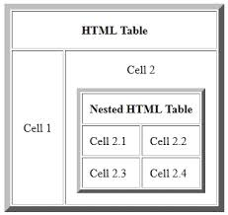
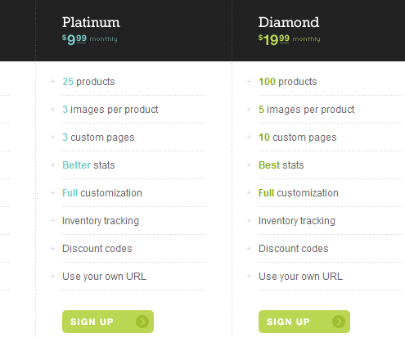
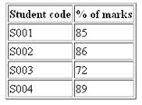
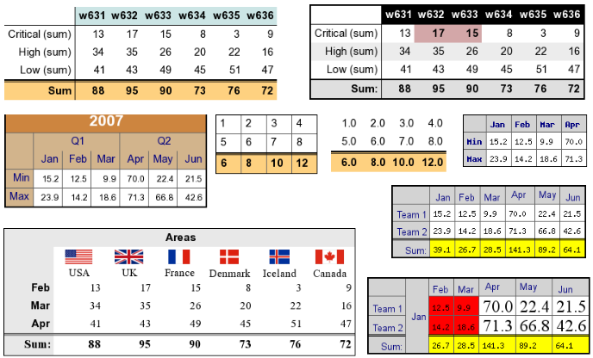
BASICS OF HTML
HTML TABLES
EXAMPLES

Slide 13
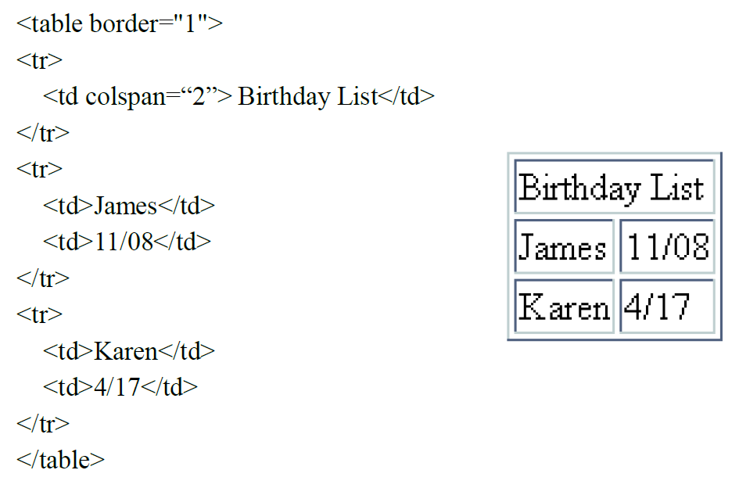
BASICS OF HTML
HTML TABLES - COLSPAN

Slide 14
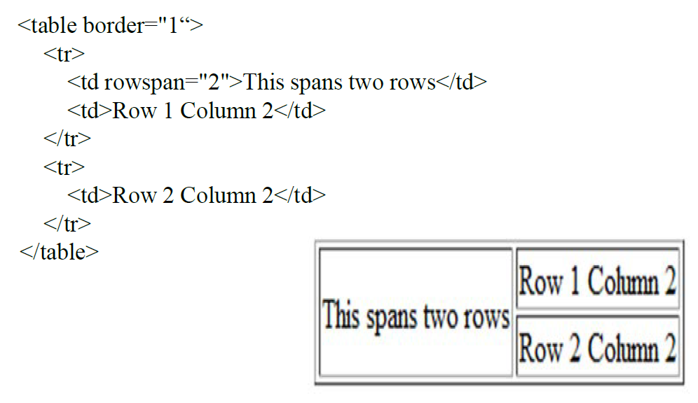
BASICS OF HTML
HTML TABLES - ROWSPAN

Slide 15
BASICS OF HTML
HTML TAG -ATTRIBUTES
**Global Attributes: class | contenteditable | contextmenu | dir | draggable | id | irrelevant | lang | ref | registrationmark | tabindex | template | title
SPECIAL CASES
<table> <td> , <th> | bgcolor | align | cellpadding | cellspacing | border | bordercolor colspan | rowspan | nowrap | align | valign | bgcolor
<hr> | size | width | color | align | noshade (No 3D cutout)
<ul> … </ul> <li> … </li> | type (disc, circle, square)
<meta> … </meta> | name | http-equiv | content
<link> … </link> | rel (stylesheet, shortcut icon) | href | type (text/css) | title
<script> … </script> | type (text/javascript) | src
 | (more after HTML Forms…..)

Slide 16
BASICS OF HTML
HTML SPECIAL CHARACTERS
© | &copy;
< | &lt;
> | &gt;
& | &amp;
[space] | &nbsp;
™ | &trade;
♠ ♣ ♥ ♦ | &spades; &clubs; &hearts; &diams;
£ ¥ ¢ $ | &pound; &yen; &cent; &#36;
Unicode characters | &#00 - &#255

Slide 17

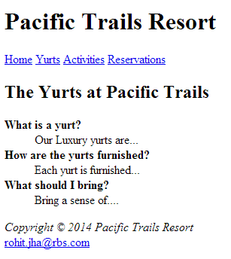
EXERCISE – DAY 1
TOURISM WEBSITE
index.html
yurts.html

Slide 18
HTML FORMS

Slide 19
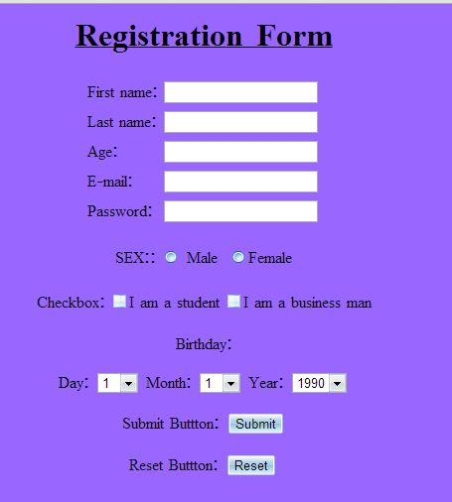
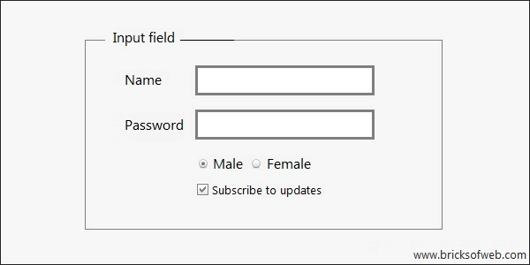
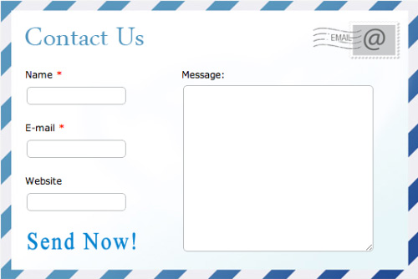
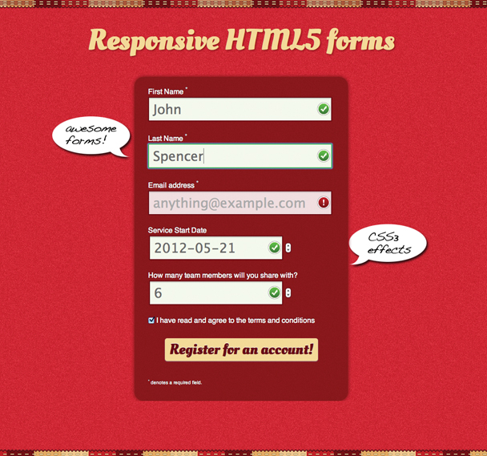
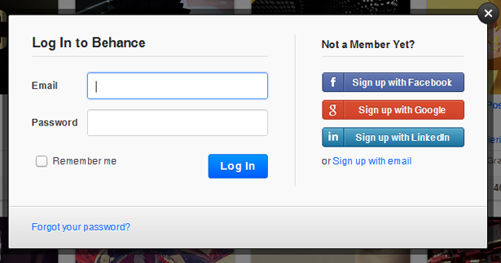
BASICS OF HTML
HTML FORMS
Why are forms needed ??

Slide 20
BASICS OF HTML
HTML FORMS - ATTRIBUTES
<FORM> TAG
action | Server side script location or REST endpoint that will process form data
method | GET – Form data passed via URL encoding POST – Form data passed as HTTP encoded entity body (as a form ‘object’)
name | Identifies the form
id | Identifies the form

Slide 21

BASICS OF HTML
HTML FORMS
<input type=“text” />
<INPUT> TAG
type | text, password, datetime, datetime-local, date, month, time, week, number, email, url, search, tel, and color
size | Specifies the width, in characters, of an <input> element
maxlength | Specifies the number of characters allowed in the <input> element
name | Identifies the element
id | Identifies the element
value | Specifies a value of the <input> element
required | Makes the <input> element as mandatory for the form submission
placeholder | Specifies the short hint describing expected value inside <input>
http://www.w3schools.com/tags/tag_input.asp

Slide 22

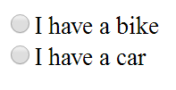
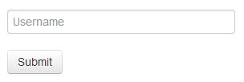

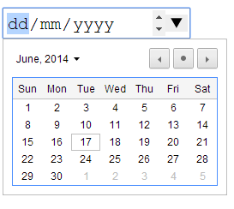

BASICS OF HTML
HTML FORMS
<input type=“checkbox” name=“vehicle” id=“Bike” /> I have a bike <br>
<input type=“checkbox” name=“vehicle” id=“Car” /> I have a car
<input type=“radio” name=“vehicle” id=“Bike” /> I have a bike <br>
<input type=“radio” name=“vehicle” id=“Car” /> I have a car
<input type="text" placeholder="Username">
<input type="submit" value="Submit">
<input type="password">
<input type=“date">
<label for="input">Label</label>
‘for’ attribute should point to input name attribute

Slide 23

BASICS OF HTML
HTML FORMS
<textarea rows=“4” cols=“15” />
<TEXTAREA> TAG
maxlength | Specifies the number of characters allowed in the <textarea> element
name | Identifies the element
id | Identifies the element
cols | Specifies the visible width of a text area
rows | Specifies the visible number of lines in a text area
wrap | Specifies the short hint describing expected value inside <textarea>
http://www.w3schools.com/tags/tag_textarea.asp

Slide 24
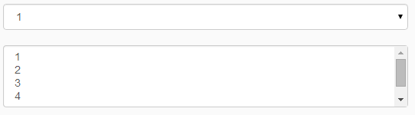
BASICS OF HTML
HTML FORMS
<select>
<option>1</option>
<option>1</option>
<option>1</option>
</select>
<SELECT> TAG
size | Specifies the number of visible options in a drop-down list
name | Identifies the element
id | Identifies the element
multiple | Specifies that multiple options can be selected at once
Selected | Attached to the <option> which has been selected by the user
http://www.w3schools.com/tags/tag_select.asp

Slide 25
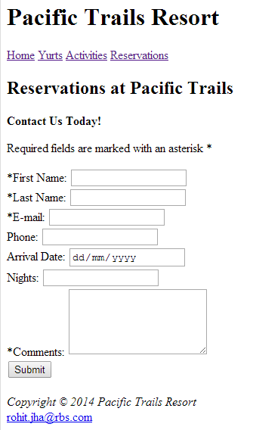
EXERCISE – DAY 1
TOURISM WEBSITE
reservations.html

Slide 26

HTML
What’s new ?
New Elements
New Attributes
Geo-Location API
Canvas API
Multimedia Support
Local Storage
Web Workers
Offline Web App

Slide 27
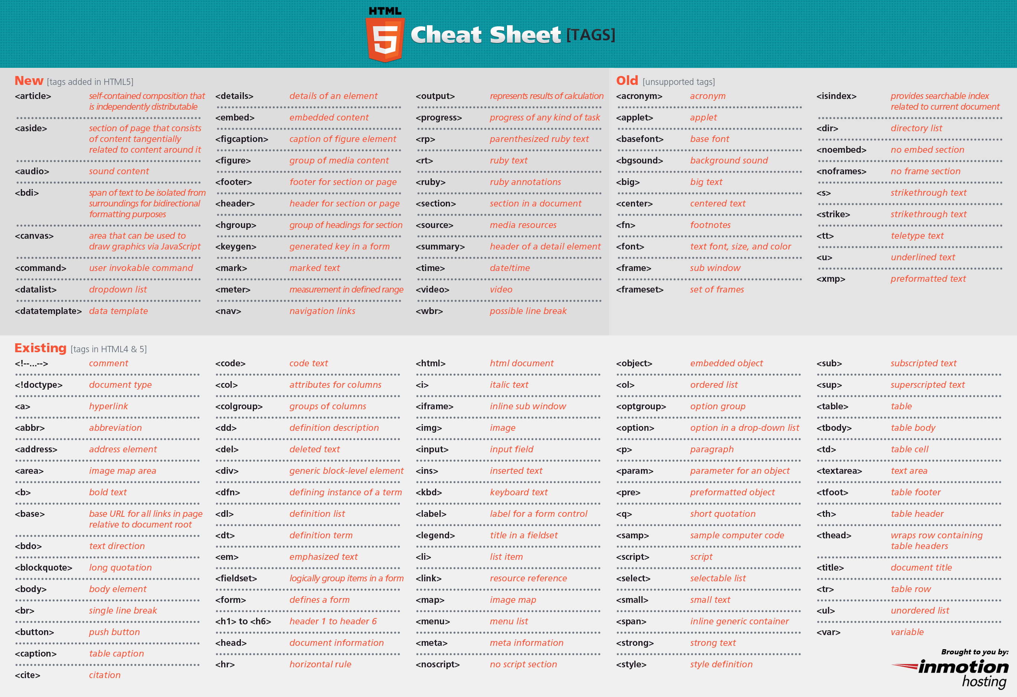

Slide 28
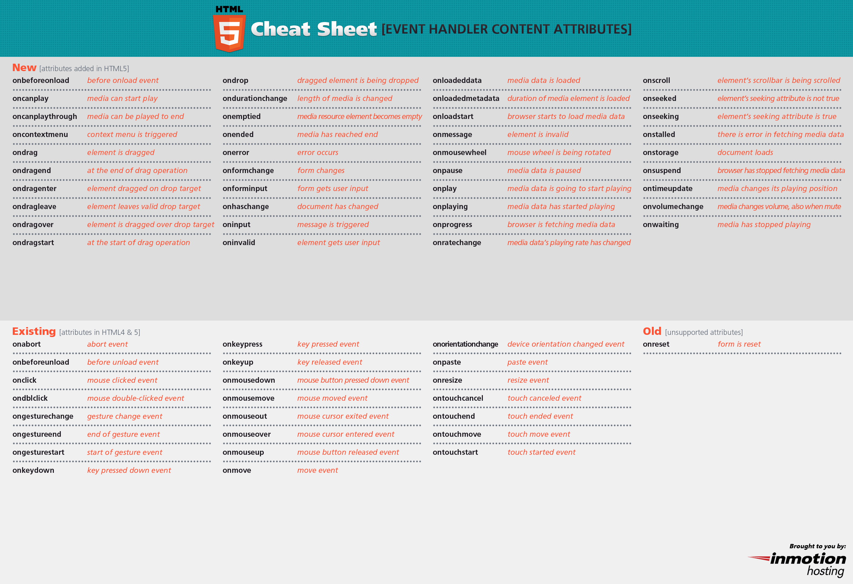

Slide 29
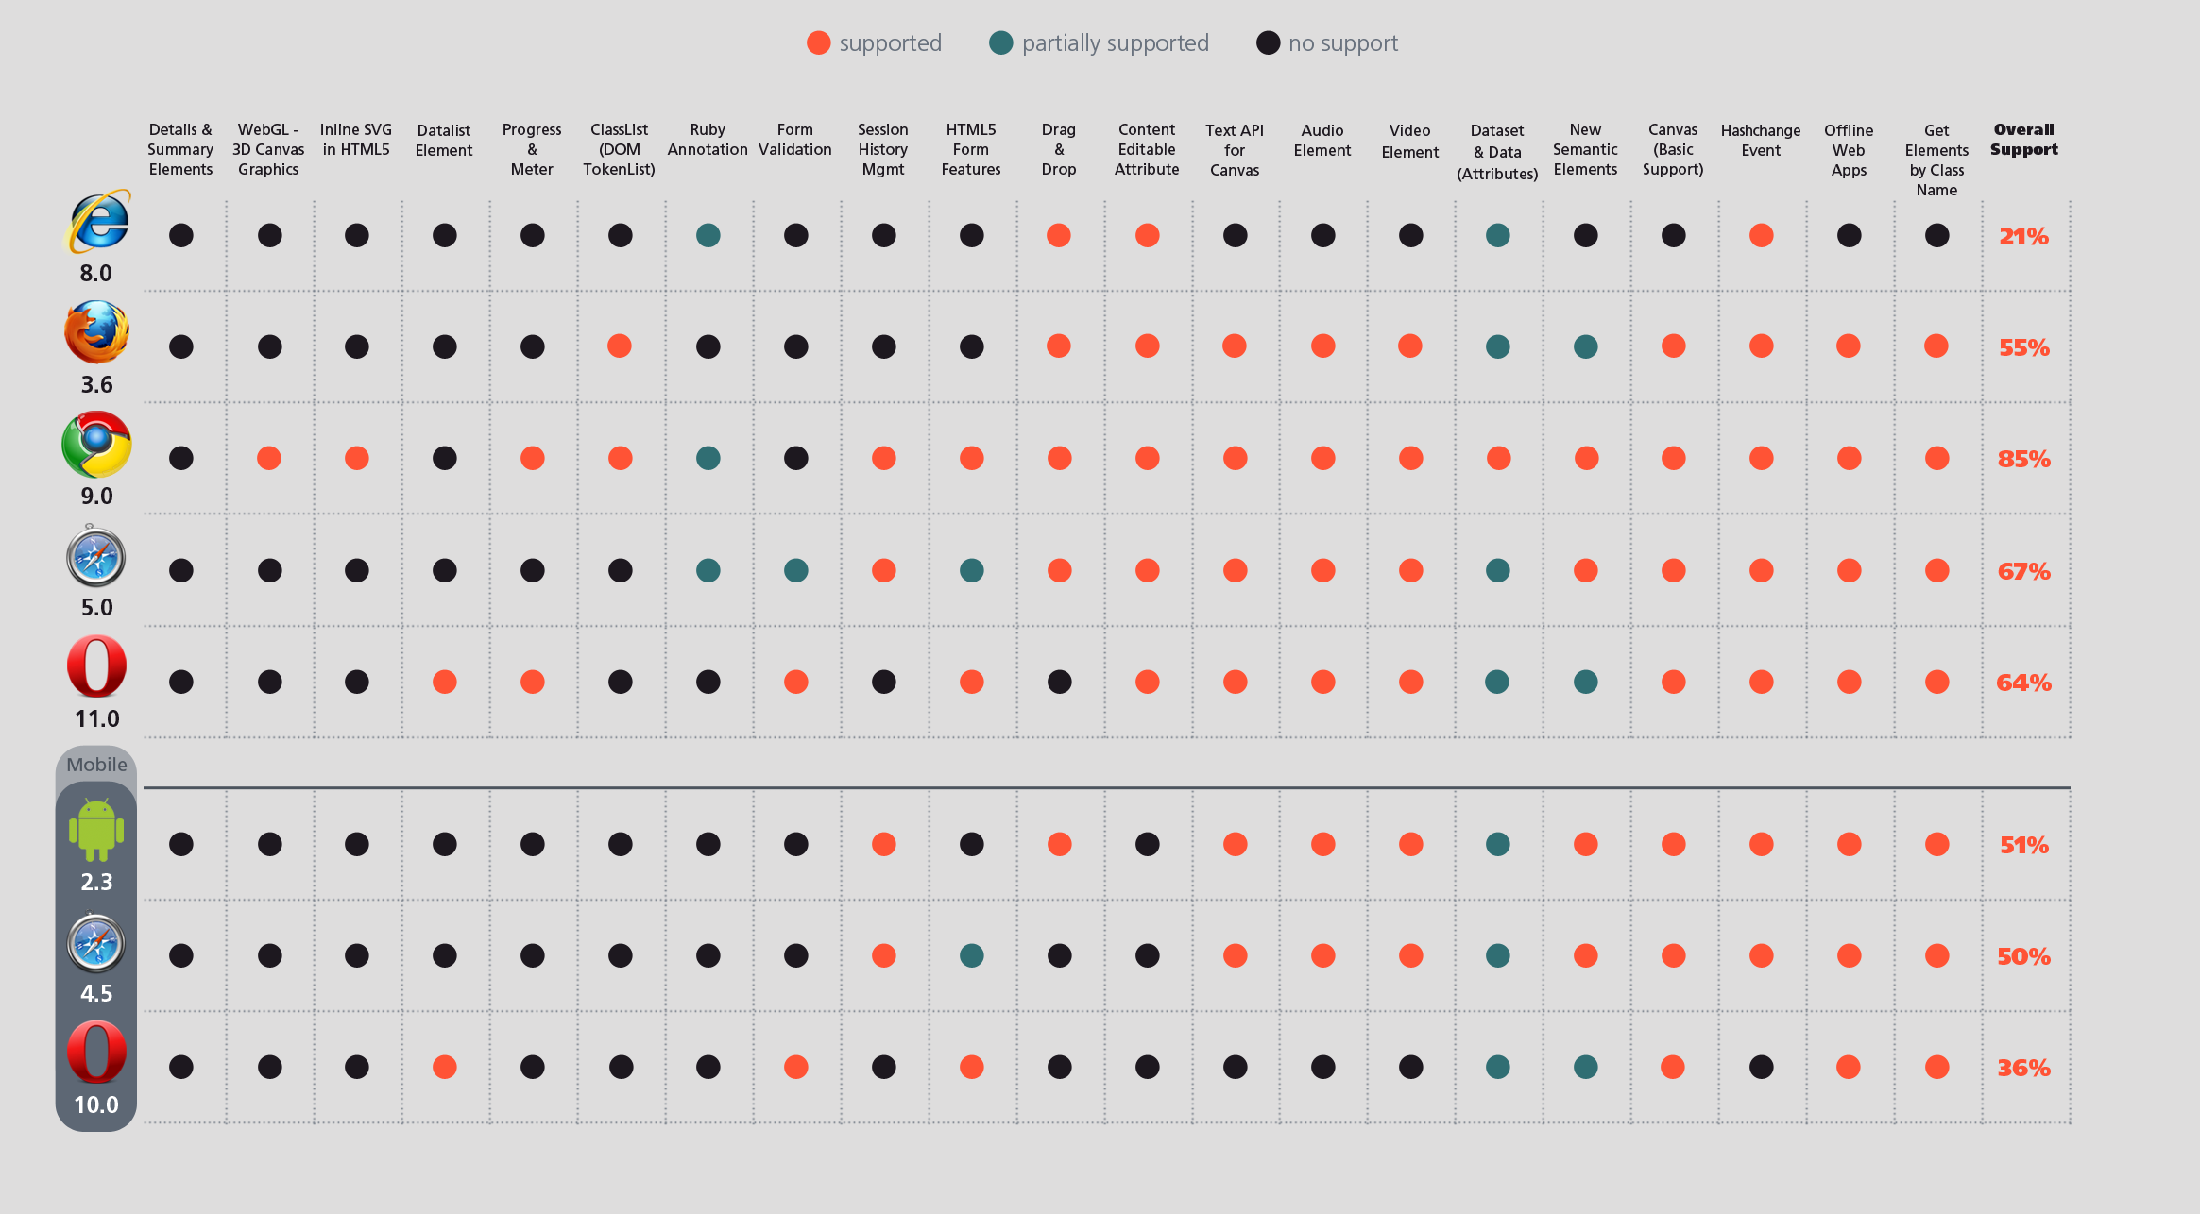
NEW IN HTML5?
BROWSER SUPPORT
http://caniuse.com

Slide 30
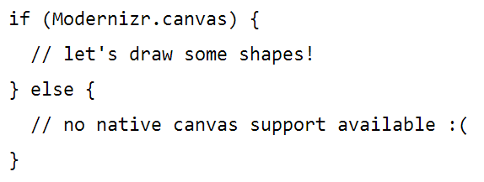
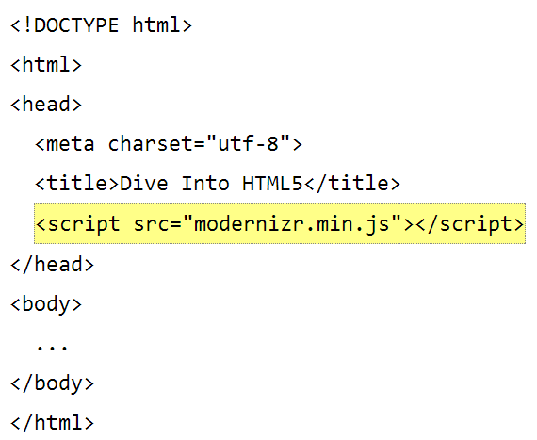
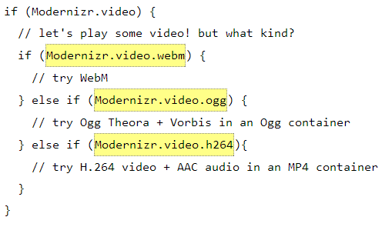
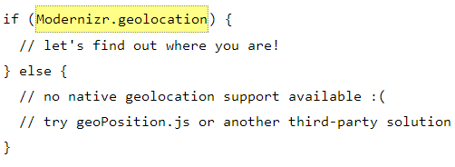
NEW IN HTML5?
DETECTING COMPATIBILITY
http://modernizr.com/
https://github.com/Modernizr/Modernizr

Slide 31
NEW IN HTML5?
ENABLING COMPATIBILITY
<!--[if lt IE 9]>
<script src="html5shiv.js"></script>
<![endif]-->
https://github.com/aFarkas/html5shiv/
This script developed by Paul Irish in 2009 enabled use of HTML5 sectioning elements in legacy Internet Explorer and provides HTML5 styling for Internet Explorer 6-9, Safari 4.x (and iPhone 3.x) and Firefox 3.x
A.k.a Polyfills
Almost all HTML5 features are now being polyfilled by Modernizr library too – section, canvas, geolocation, audio, video, IndexedDB. web SQL, web forms, websockets, app cache, history API

Slide 32
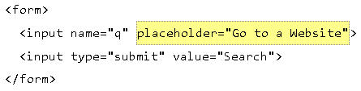
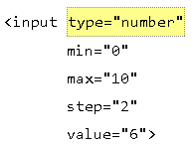
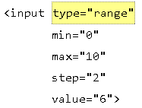
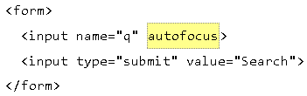
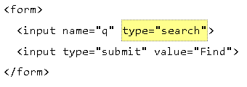
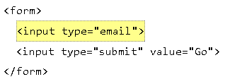
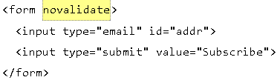
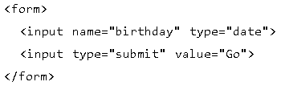
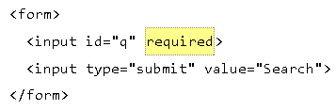
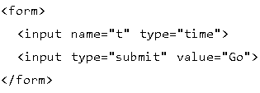
NEW IN HTML5?
NEW INPUT TYPES

Slide 33

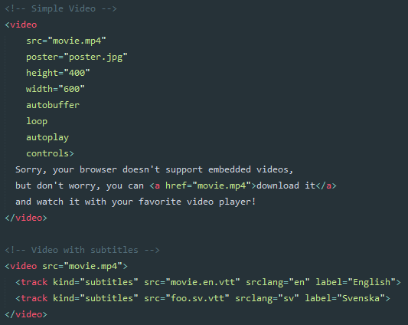
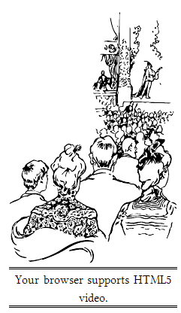
NEW IN HTML5?
VIDEO/MULTIMEDIA
Same usage and attributes for <audio> tag

Slide 34


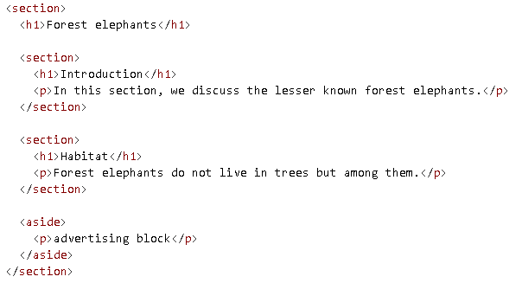
NEW IN HTML5?
SECTION
Defines a section within a document such as chapters, etc.
Better semantics & help blind users navigate your page
Cleaner DOM – every article creates a mini section with its own child-parent relationships
<aside> tag defines data within a section which is indirectly related to the content surrounding it.

Slide 35
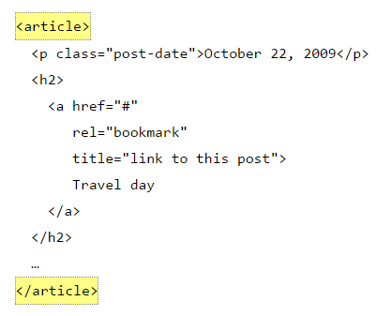
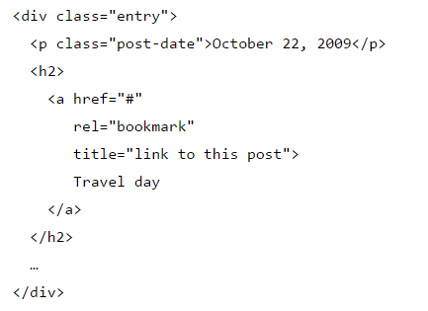
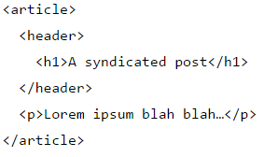
NEW IN HTML5?
ARTICLES
Better semantics & help blind users navigate your page
Cleaner DOM – every article creates a mini section with its own child-parent relationships

Slide 36
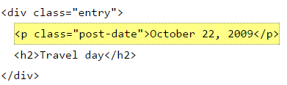


NEW IN HTML5?
DATES/TIMES
A machine-readable timestamp
Human readable text content – semantically correct
A pubdate flag – if inside an <article> tag, represents date of article else means date of page publication.

Slide 37
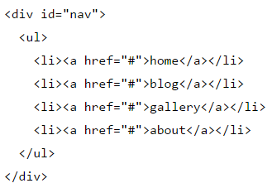
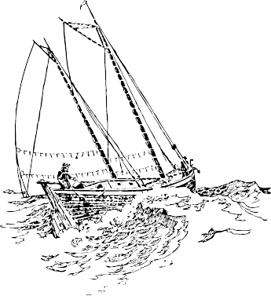

NEW IN HTML5?
NAVIGATION
Semantically correct and readable to people with disabilities
Ability to distinguish between any set of links on the page vs. navigational links on the page markup

Slide 38


NEW IN HTML5?
HEADER/FOOTER
Better semantics – the tag actually means what it encapsulates
Screenreaders use document outlines to help blind users navigate your page
Better document outline – instead of creating phantom nodes for parent-children relationship

Slide 39


NEW IN HTML5?
HEADER/FOOTER

Slide 40



NEW IN HTML5?
GEO-LOCATION API
https://maps.googleapis.com/maps/api/staticmap?center=1.2800945000000001,103.8509491&zoom=13&size=300x300&sensor=false

Slide 41



NEW IN HTML5?
CANVAS
a resolution-dependent bitmap canvas which can be used for rendering graphs, game graphics, or other visual images on the fly.
The cheat sheet in the references show more of the canvas API

Slide 42
RESOURCES
https://github.com/jharohit/web-fundamentals-course

